Slide 1

FPGA Contest 2020
Shared House Live Sensors
Corentin Damman
October 30, 2020
Notes:
Choose from the existing cover option or create your own replacing the visual from the Photo library on Brand Connect

Slide 2
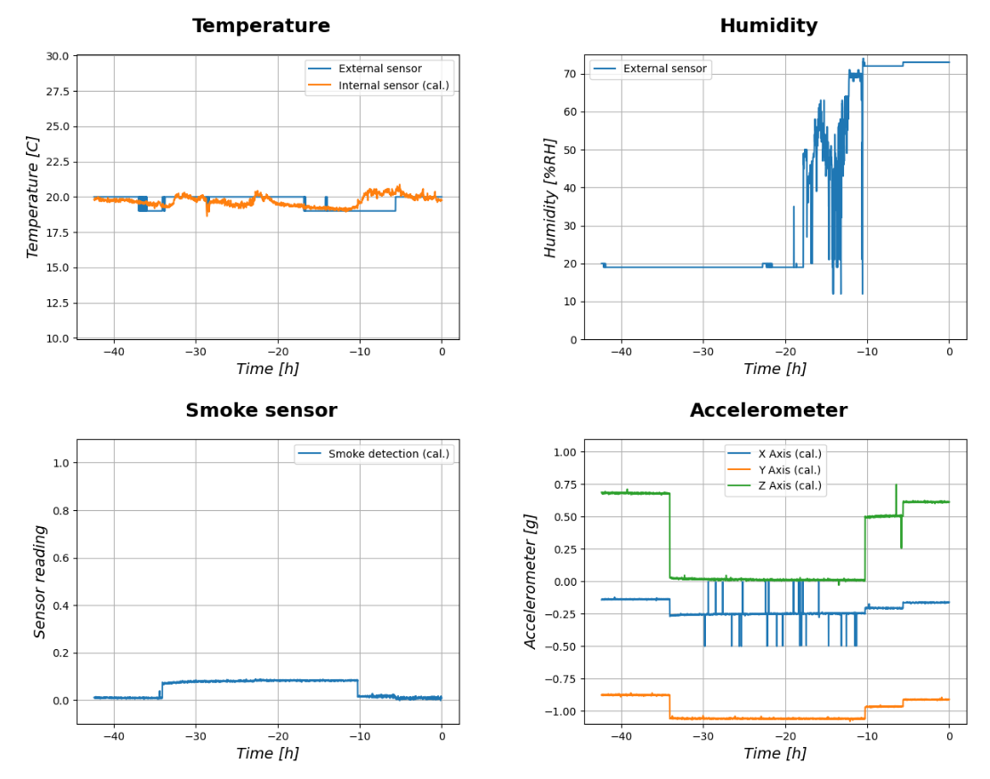
Agenda
Project name
Abstract
Idea
Concept
Realization
Status
Project outlook

Slide 3
Arrow FPGA Contest 2020
Summary
The „Shared House Live Sensors“ project allows to share multiple sensors data live on a website
It enables my roommates to see live data from our living room
Features:
Updates every minute, data kept in a database for the last 7 days
Live data available on this website: https://pi.cdamman.eu/livesensors
5 different sensors
Temperature with AnalogMax sensor
Temperature & Humidity with DHT11 sensor
Smoke sensor with AnalogMax sensor
Accelerometer with AnalogMax sensor

Slide 4
Arrow FPGA Contest 2020
IdEa
My roommates complain all the time that
It is too cold in their room
It is too hot in the living room
There are toast burnt in the toaster
etc …
All these are very subjective feelings
What if I could give them objective data to prove they‘re wrong?

Slide 5
Arrow FPGA Contest 2020
Concept
How to do that?
What we need
A board with a lot of sensors, including (at least) temperature (“It’s too cold/too hot here” issue) and smoke detector (“burnt toast” issue)
An online website
A connection between the board and the website

Slide 6
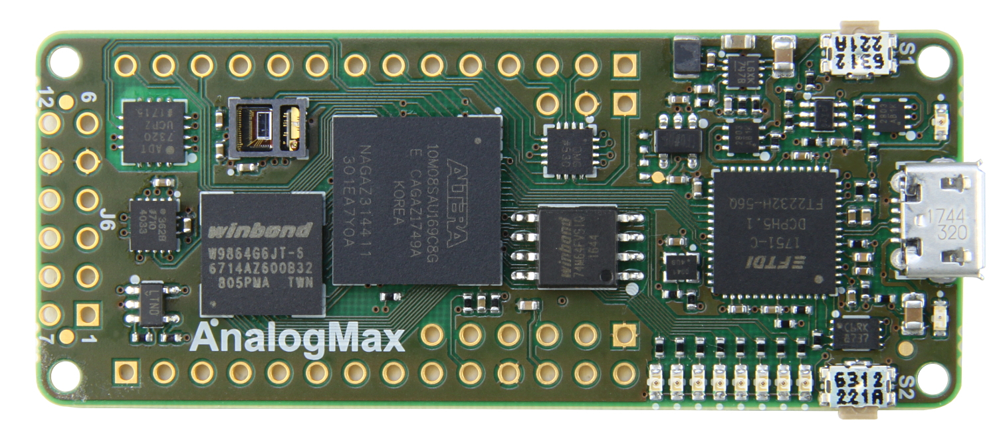
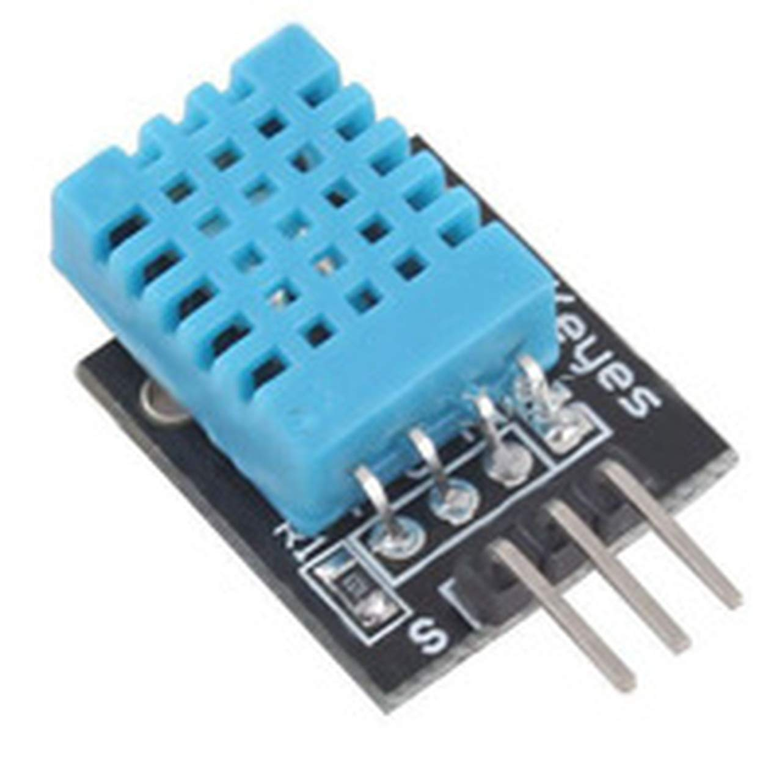
Arrow FPGA Contest 2020
Realization
The AnalogMax board is the perfect fit for this!
Embeds a lot of sensors
Enables to add more sensors with GPIOs and ADCs
I already added one DHT11 sensor (1-Wire protocol implemented in VHDL)
An embedded NIOS processor is used to gather all data from sensors and communicate with the serial USB link
For the website:
I used a Raspberry Pi to host the server
The AnalogMax board is connected using serial USB link
A Python script is called every minute to acquire data and update plots

Slide 7
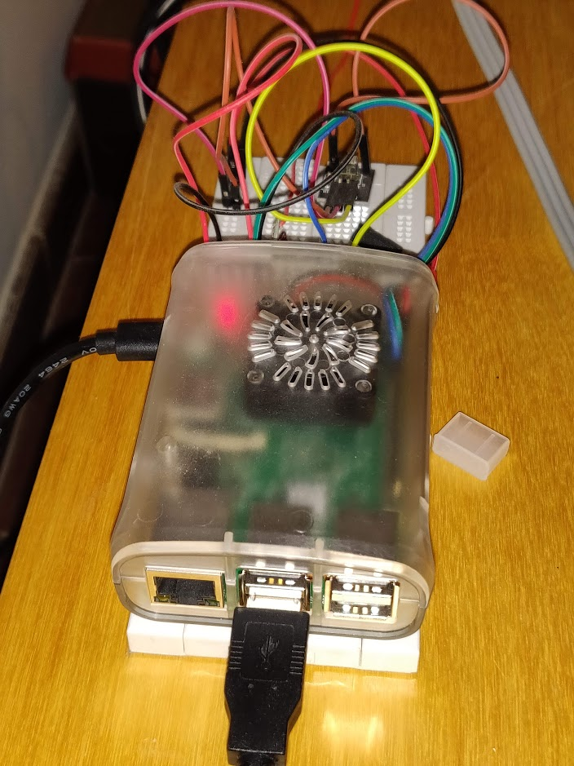
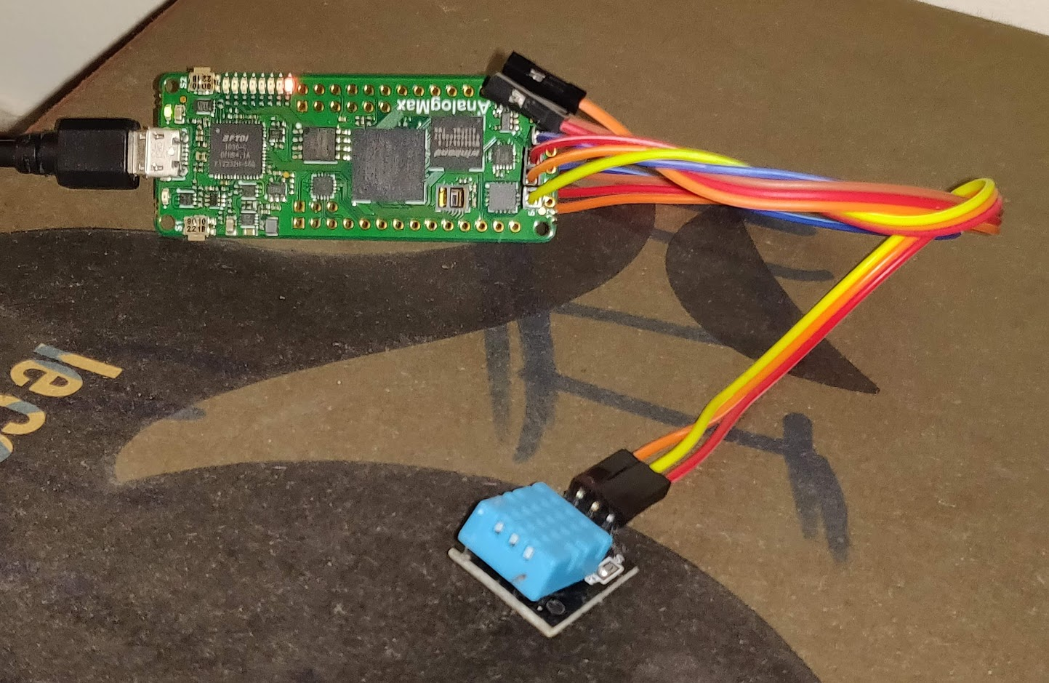
Arrow FPGA Contest 2020
Status
Live sensors are now available online for my roommates…
… but also the rest of the world!
Website link: https://pi.cdamman.eu/livesensors
Github repository: https://github.com/cdamman/SharedHouseLiveSensors
AnalogMax board
RaspBerry Pi with serial USB
DHT11 sensor

Slide 8
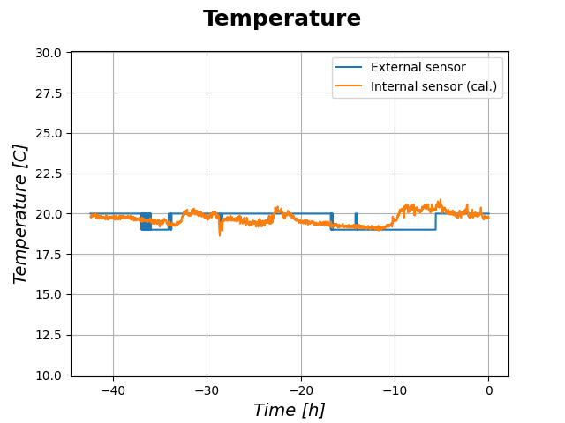
Arrow FPGA Contest 2020
Status: temperature sensors
My roommate turned on the heating
All cooking in the living room
During the night, it’s colder!

Slide 9
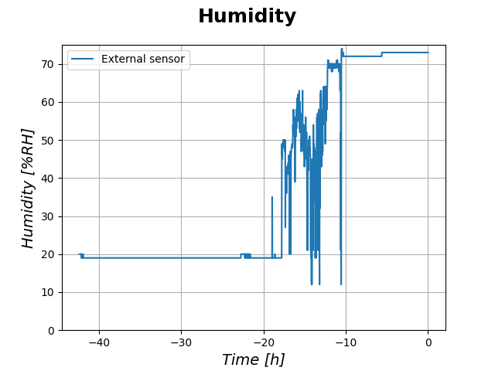
Arrow FPGA Contest 2020
Status: temperature sensors
Cooking + window opened during autumn

Slide 10
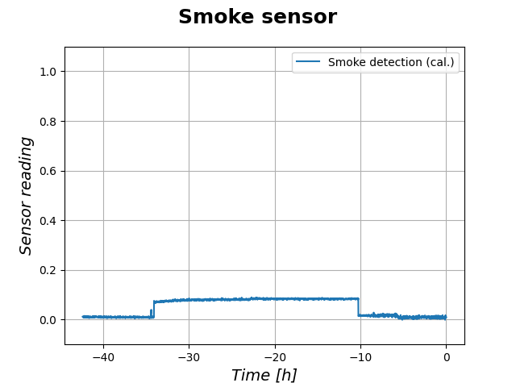
Arrow FPGA Contest 2020
Status: temperature sensors
Who burnt a toast??!

Slide 11
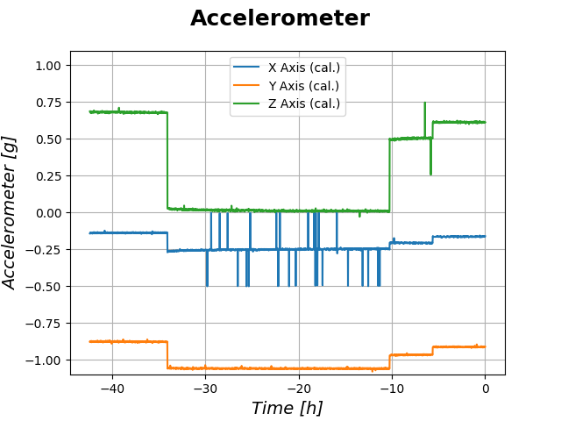
Arrow FPGA Contest 2020
Status: temperature sensors
Who moved my board??!

Slide 12
Arrow FPGA Contest 2020
Project outlook
Next steps and future plans:
Add more sensors
Motion sensor: is there someone in the living room?
Add “is the heating on?” indicator on the website
If living temperature > temperature programmed in the thermostat -> the heating is on
…

